Slide 1

HARD DISK DRIVE
NGOSA GATHAMS
Msc Computer Science and IT
Msc Cyber Security

Slide 2

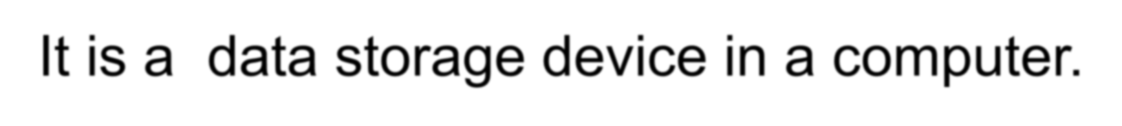

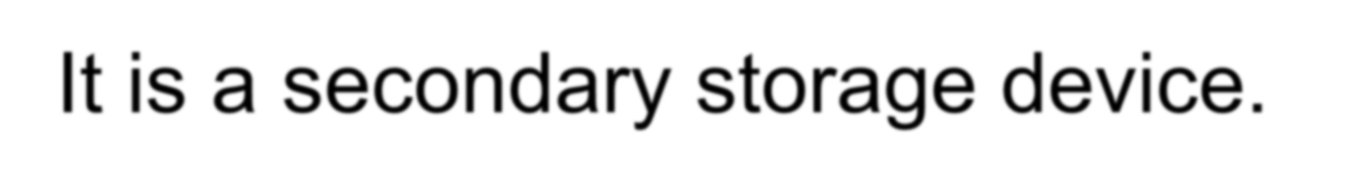
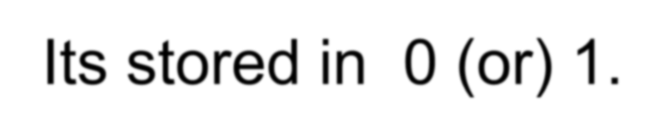



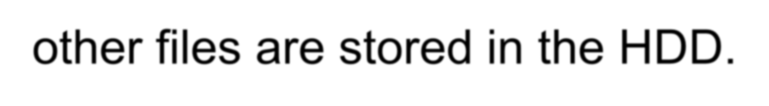
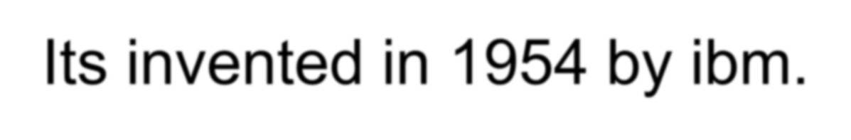

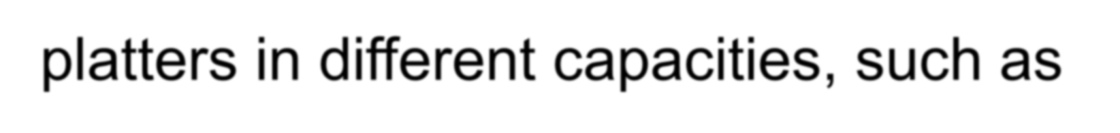
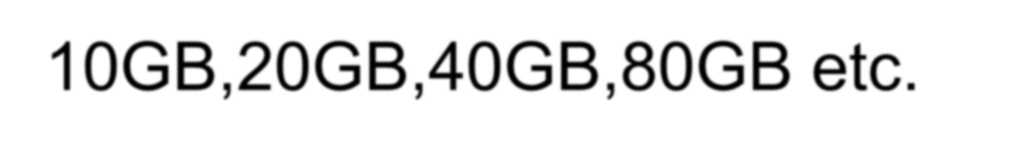
HARD DISK DRIVE
It is a data storage device in a computer.
It is a secondary storage device.
Its stored in 0 (or) 1.
The operating system, software and most other files are stored in the HDD.
Its invented in 1954 by ibm.
Nowaday,HDD with3.5 inch or 5.25 inch platters in different capacities, such as
10GB,20GB,40GB,80GB etc.

Slide 3
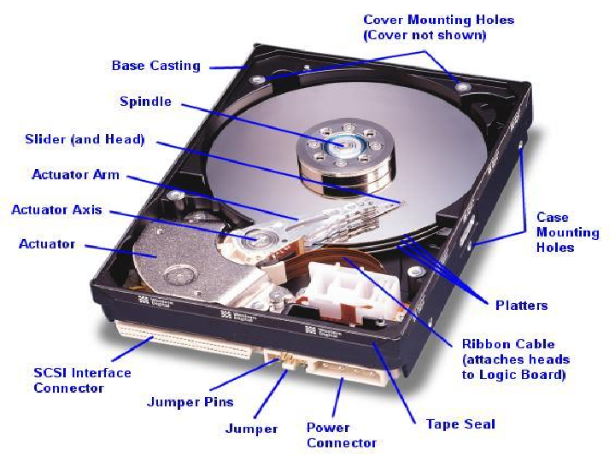

Slide 4
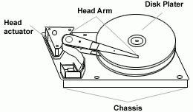
Main components for Hard disk drive
Disk platter
Stepper motor
Spindle motor
Read and write head
  Arm

Slide 5
DISK PLATTER
The platter is made up of a magnetic material, in the flat disk part of the drive.
The data stored in the platter.
Each set of magnetic particles is collection a unit called a bit.
New hard-drive technology uses thin-film metals and glass platters to increase efficiency and drive storage capacity.
STEPPER MOTOR
  Use stepper motors for controlling read/write head position.
  Stepper motors usually use +12V power, but some new low- power drives use +5V power source.
SPINDLE MOTOR
It control the platter.
Ithis motor rotates at a speed of 3600 to 10,000 r.p.m.
All the platter moves in the same direction.

Slide 6

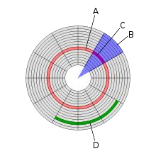
READ AND WRITE HEAD
The heads read and write the information to the drive platter.
The head writes magnetic information on the platter.
HEAD ARM
Used for read and write operations.
Disk structures
(A) Track (B sector
(C) Cylinder
(D) Storage capacity

Slide 7
Track :
The HDD is divided into number of concentric
circlues called tracks.
Circular path in sector is called track.
Sector :
Data storage area in one track multiple divided
into the multiple block is called sector.
Each sector can have 512 bytes of the data.
Cylinder: A set of corresponding tracks in all sides of a
hard disk is called cylinder.
Storage capacity:
below:
storage capacity=number of cylinder’s*tracks per cylinder*
sector per tracks*bytes per sector.
Its having a fourmula shown

Slide 8
Jumper setting for
It have 8 Pins
2 Rows
4 pairs
Pins
Rows
pairs
No use
Cable select
Slave
Master

Slide 9
Partition for HDD
1.Primary Partition:
Windows operating systems must be located in a primary partition.
  Only primary partitions can be used to boot the operatingsystem.
2.Extended Partition:
  A hard disk may contain only one extended partition.
the extended partition can be subdivided into multiple logical partitions (Other than OS is a Extended Partition).
3.Logical Partition:
Linux operating systems can be installed into (and run from)
logical partitions.
4.Active Partition:
  Only one partition on a computer can be set as an active partition or bootable partition.
For example, if you are using Microsoft Windows the partition
that contains Windows is the active partition.

Slide 10
File system in HDD
FAT (File Allocation Table)
NTFS (New Technology File System
FAT | NTFS
Its not a security | Its a security
Partition size is max 32GB | Partition size is 1 (Tera Bytes)
Does not support data compersion | It support data compersion
Does not support disk quota | Its support disk quota
Window os conformability (95,98.ms-dos) | Window os conformability ( 2000,xp ,vista,win 7 )

Slide 11
TYPES OF INTERFACEING IN HDD
They are three types of interfacing in hard disk
IDE
SATA
SCSI
IDE (Integrated Device Electronics) / PATA
(Parallel Advanced Technology Attachment)
It has a 40 pin connector.
Data transfer rate is 133mbbs.
3 .when installed this type of hard drives ensure that the jumpers are correctly configured.
4. If you have two devices connected to one IDE controller.
( one must be set to master and the other must be set to
slave).

Slide 12
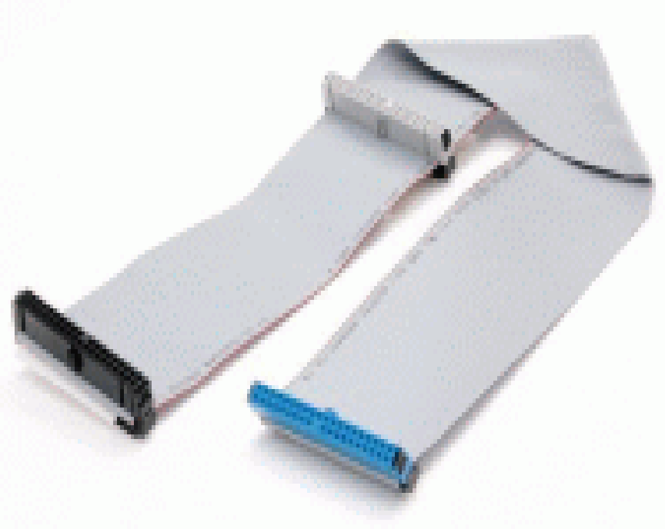

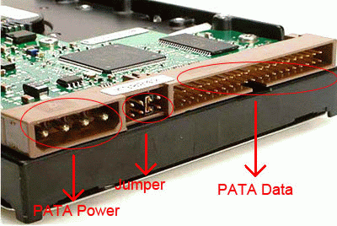
IDE data cable and connector
in HDD

Slide 13

SATA (Serial Advanced Technology Attachment)
It has a 7pin connector.
It is the latest high-speed type of hard drive connectors.
Data transfer rate is 300Mb/s. As there are faster than old IDE interface.
the latest hard drives are using this type of interface.
As there are faster than old IDE interface.
SATA socket, power connector and data cable
If the motherboard have
the SATA connectors/sockets as shown the picture.

Slide 14

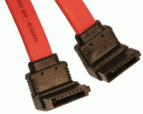
SATA HDD power connector.
SATA Data cable for HDD
.

Slide 15
SCSI (Small Computer System Interface)
It has a 50 or 68 pin connector.
The data transfer rate is 600Mb/s .
These require a SCSI adapter card connected into the system.
Nowadays, most desktop computers did not use the SCSI.

Slide 16
Main Problem Created in HDD
No Operating System
(No operating system in Hard Disk)
Disk boot Failure
(Cable Problem) OR (HDD Not Detect)

Slide 17
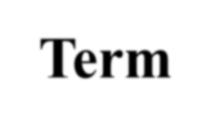
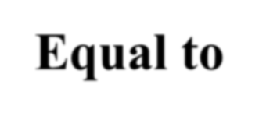

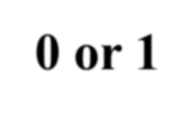

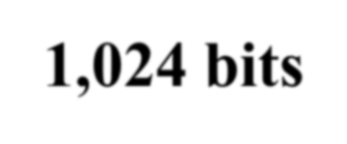
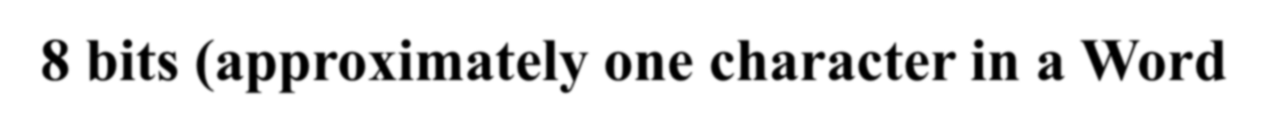
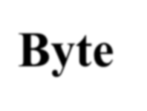
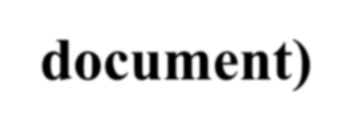

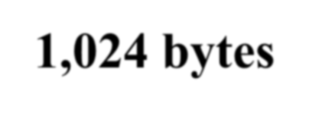
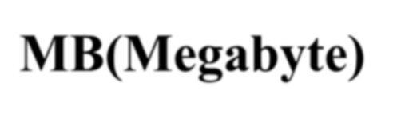
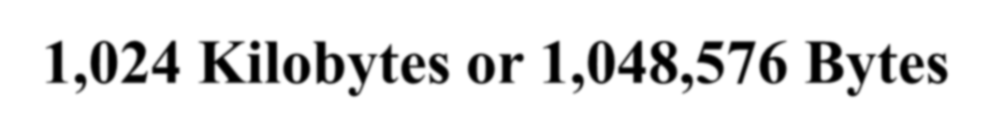

HDD Capacity and Size Information
When pure chasing a hard disk drive, the term megabytes, gigabytes or terabytes may be confusing terms. The following table gives you an example of each of these terms and how they compare to other sizes.
Term | 0 or 1 | Equal to
Bit
Kb(Kilobit) | 1,024 bits
 | 8 bits (approximately one character in a Word document)
Byte
KB(Kilobyte)
 | 1,024 bytes
MB(Megabyte) 1,024 Kilobytes or |  | 1,048,576 Bytes
GB(Gigabyte) | 1,024 Megabytes or 1,073,741, 824 Bytes

Slide 18
TB(Terabyte) | 1,024 Gigabytes or 1,099,511,627,776 Bytes
PB(Petabyte) | 1,024 Terabytes or about 1,000,000,000,000,000 Bytes
EB(Exabyte) | 1,024 Petabytes or about 1,000,000,000,000,000,000 Bytes
ZB(Zetabyte) | 1,024 Exabytes or about 1,000,000,000,000,000,000,000 Bytes
YB(Yottabyte) | 1,024 Zetabytes or about 1,000,000,000,000,000,000,000,000 Bytes
Note: Example: 1 GB = 1,024 MB but for easy calculations, normally we just say 1 GB = 1,000 MB by ignoring 24 MB size. Also, 1 MB = 1,000 KB, etc.

Slide 19



